Slide 1
Dimensional Modeling
By Dr. Gabriel

Slide 2
Dimensional Modeling
Dimensional modeling
  Logical design technique for structuring data
    It is intuitive to business users
      Easy-to-understand
    Fast query performance
  Primary constructs of a dimensional model
    fact tables
    dimension tables

Slide 3
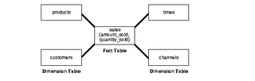
Star Schema
A fact table
Multiple dimension tables
Example: Assume this schema to be of a retail-chain. Fact will be revenue (money). How do you want to see data is called a dimension.

Slide 4
Facts
Facts
  Measurements
  Numeric
  Additive
    Critical
    BI applications do not retrieve a single fact table row; data is summarized
  Semi-additive
    Cannot be summed across time periods
    Examples: account balances, inventory levels
  Non-additive
    Cannot be summed across any dimension
    Are stored in dimension tables

Slide 5
Fact Tables
Fact tables
  Store numeric additive facts
Conformed facts
  Facts with identical definitions
    May have same standardized name in separate tables
For non-conformed facts
  Different interpretations must be given different names

Slide 6
Fact Tables
Fact table keys
  Complex key that consists of foreign keys from intersecting dimension tables
  Every foreign key must match a unique primary key in the corresponding dimension table
    Foreign keys should not be null
      Special keys such as “unknown”, “N/A”, etc. should be used instead.

Slide 7
Fact Tables
Fact table granularity
  Data should be at the lowest, most detailed atomic grain captured by a business process
    Flexibility in querying/reporting
    Scalability

Slide 8
Dimension Tables
Dimension tables
  Consist of highly correlated groups of attributes that represent key objects in business such as products, customers, employees, facilities
  Store attributes for
    Query constraining/filtering
    Query result labeling
Dimensions
  Can be easily identified when business users use “by” word
    Example: by year, by product, by region, etc.

Slide 9
Dimension Tables
Dimension attributes
  Textual fields
  Numeric values that behave like text
    Non-additives
  Requirements
    Labels consist of full worlds
    Descriptive
    No missing values
    Discretely valued (contain only 1 value for each row in the dimension table)
    Quality assured (no misspelling, obsolete or orphaned values, different versions of the same attribute)

Slide 10
Dimension Tables
Dimension tables are small with regard to the number of rows
Storing descriptions for each attribute is critical
  Easy-to-use for business users
Rows are uniquely identified by a single key, usually, a sequential surrogate key

Slide 11
Dimension Tables
Advantages of using surrogate keys
  Performance
    Efficient joins
    smaller indexes
    more rows per block
  Data integrity
    When the keys in operational systems are reused
      Discontinued products, Deceased customers, etc.
  Mapping when integrating data from different sources
    Keys from different sources may be different
    Mapping table of the surrogate key and keys from different sources

Slide 12
Dimension Tables
Advantages of using surrogate keys (Cont)
  Handling unknown or N/A values
    Ease of assignment a surrogate key value to rows with these values
  Tracking changes in dimensional attribute values
    Creating new attributes and assigning the next available surrogate key

Slide 13
Dimension Tables
Disadvantages of using surrogate keys
  Assignment and management of surrogate keys and appropriate substitution of these keys for natural keys – extra load for ETL system
    Many ETL tools have built-in capabilities to support surrogate key processing
    Once the process is developed, it can be easily reused for other dimensions

Slide 14
Conformed Dimensions
a.k.a. master or common reference dimensions
Shared across the DW environment joining to multiple fact tables representing various business processes
2 types
  Identical dimensions
  One dimension being a subset of a more detailed dimension

Slide 15
Conformed Dimensions
Identical dimensions
  Same content, interpretation, and presentation regardless of the business process involved
  Same keys, attribute names, attribute definitions, and domain values regardless of domain values they join to
  Example: product dimension referenced by orders and the one referenced by inventory are identical
One dimension being a perfect subset of a more detailed, granular dimension table
  Same attribute names, definitions, and domain values
  Example: sales is linked to a dimension table at the individual product level; sales forecast is linked at the brand level

Slide 16
Conformed Dimensions
Product Dimension
Product key PK
Product description
SKU number
Brand description
Sub class description
Class description
Department description
Color
size
Display type
Sales Fact Table
Date key FK
Product key FK
… other FKeys…
Sales quantity
Sales amount
Sales Forecast Fact Table
Month key FK
Brand key FK
… other FKeys…
Forecast quantity
Forecast amount
Brand Dimension
Brand key PK
Brand description
Sub class description
Class description
Department description
Display type

Slide 17
Conformed Dimensions
Benefits
  Consistency
    Every fact table is filtered consistently and results are labeled consistently
  Integration
    Users can create queries that drill across fact tables representing different processes individually and then join result set on common dimension attributes
  Reduced development time to market
    Once created, conform dimensions are reused

Slide 18
Dimensional Design Process
Based on business requirements and data realities
Step 1 – choose the business process
Step 2 – declare the grain
Step 3 – identify dimensions
Step 4 – Identify facts

Slide 19
Enterprise Bus Architecture
Requirements are gathered and represented in a form of Enterprise Data Warehouse Bus Matrix
  Each row corresponds to a business/process
  Each column corresponds to a dimension of the business
    Each column is a conformed dimension
Enterprise Data Warehouse Bus Matrix documents the overall data architecture for DW/BI system

Slide 20
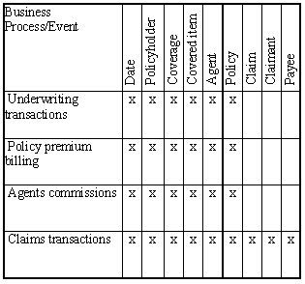
Enterprise Bus Architecture Matrix

Slide 21
Enterprise Bus Architecture Matrix
Possible Problems:
  Level of details for each column and row in the matrix
  Row-related
    Listing departments/imitating organizational chart instead of business processes
    Listing reports and analytics related to business process instead of the business process itself
      Ex. Shipping orders business process supports various analytics such as customer ranking, sales rep performance, product movement analyses

Slide 22
Enterprise Bus Architecture Matrix
Possible Problems (Cont):
  Column-related
    Generalized columns/dimensions
      Example: “Entity” column is too general as it includes employees, suppliers, contractors, vendors, customers
    Too many columns related to the same dimension
      Worst case when each attribute is listed separately
      Example: Product, Product Group, LOB are all related to the Product dimension and should be listed as one.

Slide 23
Date/Time Dimensions
Standard date dimension table at a daily grain
Rationale: remove association with calendar from BI applications
Use numeric surrogate keys for date dimension tables
Date Dimension
Date key pk
Calendar Date
Calendar Month
Calendar Day
Calendar Quarter
Calendar Half year
Calendar Year
Fiscal Quarter
Fiscal Year
…

Slide 24
Date/Time Dimensions
Time of day should be treated as dimension only if there are meaningful textual descriptions for periods within the day
  Example; lunch hour, rush hours, etc.
Otherwise, time of day needs to be represented as a simple non-additive fact or a date/timestamp

Slide 25
Date/Timestamp
Used in the fact table to support precise time interval calculated across fact rows
  Calculations to be performed by ETL system
  Example: elapsed time between original claim date and first payment date

Slide 26
Multiple Time Zones
Express time in coordinated universal time (UTC)
Additionally, may be expressed in local time
Other options: use a single time zone (for example, ET) to express all times in this zone
local call date
dimension
Call Center Activity Fact
Local call date key FK
UTC call date key FK
Local call time of day fk
UTC call time of day fk
…
Local call time of
day dimension
UTC call date
dimension
UTC call time of
day dimension

Slide 27
Degenerate Dimensions
Occur in transaction fact tables that have a natural parent-child structure
Key remains the only attribute left after other attributes got separated into dimensions
Key should be the actual transaction number
Stored in a fact table - do not create a corresponding dimension table

Slide 28
Degenerate Dimensions
Example:
DIM CUSTOMER
Customer key
customer id
customer lname
customer fname
ORDERS TRANSACTIONS
order#
customer id
customer lname
customer fname
shipto street address
shipto city
shipto state
shipto zip
order total amount
discount amount
net order amount
payment amount
order date
ORDERS FACTS
customer key
shipto address key
order date key
order total amount
discount amount
net order amount
payment amount
order#
DIM SHIPTO ADDRESS
Shipto address key
shipto street address
shipto city
shipto state
shipto zip
DIM Order Date
Order date key
Calendar date
Calendar month
…

Slide 29
Slowly Changing Dimensions
Dimension table attributes change infrequently
Mini-dimensions
  Separating more frequently changing attributes into their own separate dimension table, a.k.a. mini-dimension
3 types of handling slowly changing dimensions
  Overwrite the dimension attribute
  Add a new dimension row
  Add a new dimension attribute

Slide 30
Slowly Changing Dimensions - Overwrite the dimension attribute
New values overwrite old ones
No history is kept
Problems occur if data was previously aggregated based on old values
  Will not match ad-hoc aggregations based on new values
  Previous aggregations need to be updated to keep aggregated data in-sync.

Slide 31
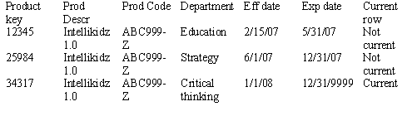
Slowly Changing Dimensions - Add a new dimension row
Most popular technique
New row with new surrogate PK is inserted into dimension table to reflect new attribute values
Both, old and new values are stored along with effective and expiration dates, and the current row indicator
Example:

Slide 32
Slowly Changing Dimensions - Add a new dimension attribute
Used infrequently
A new column is added to the dimension table
  Old value is recorded in a “prior” attribute column
  New value is recorded in the existing column
  All BI applications transparently use the new attribute
  Queries can be written to access values stored in the “prior“ attribute column

Slide 33
Role-playing Dimensions
Same physical dimension table plays different logical role in a dimension model
Example: multiple date dimensions
Order Date Dimension
Order date key PK
Order date
Order date day of week
Order date month
…
Order Transaction Fact
Order date key FK
Ship date key FK
Product key FK
Order amount
…
Ship Date Dimension
Ship date key PK
Ship date
Ship date day of week
Ship date month
…

Slide 34
Role-playing Dimensions
Other examples:
  Customer (ship to, bill to, sold to)
  Facility or port (origin, destination)
  Provider (referring, performing)
Stored in the same physical table but presented in a separately-labeled view
Implemented using views or aliases depending on the database platform

Slide 35
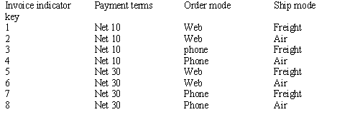
“Junk” Dimensions
Miscellaneous flags and text attributes that cannot be placed into one of existing dimension tables
Store them in a “junk” dimension
  Store as unique combinations
  Example:
  Data profiling is useful in identifying junk dimension candidates

Slide 36
Snowflaking
Occurs when dimension tables are normalized
Increases complexity for users
Decreases performance
Brand dimension
Brand key pk
Brand description
Subcategory key FK
Product Dimension
Product key PK
Product Descr
SKU number
Brand key FK
Package type key FK
Subcategory dimension
Subcategory key pk
Subcategory description
Package type dimension
Package type key pk
Package type descr

Slide 37
Outrigger Dimensions
Look like a beginning of a snowflake
Example:
  Large number of attributes
  Different grain
  Different update frequency
Customer dimension
Customer key PK
Fname
Lname
Address
County
County demographics
…
Fact table
Customer key FK
….
County demographics
Outrigger dimension
County Demogr key
Total population
Males
Female
Under 18
…

Slide 38
Bridge Tables
Used to implement variable-depth hierarchies
Should be used only when absolutely necessary
  Negatively affect usability
  Decrease performance
Example: reporting revenue for customers who has subsidiary relationship
Customer hierarchy
bridge
Parent Customer key
Subsid. Customer key
#levels from parent
Bottom flag
Top flag
Fact table
date key FK
Customer key F
…
Customer dimension
Customer key FK
….

Slide 39
3 Fundamental Fact Table Grains
Transaction
  One row per transaction/line of transaction
  Rows are inserted into fact tables only when a transaction activity occurs

Slide 40
3 Fundamental Fact Table Grains
Periodic snapshot
  At predetermined intervals snapshots of the same level of details are taken and stacked consecutively in the fact table
  Example: most financial reports, bank account value
  Complements detailed transaction facts but not substitutes them
  Share the same conformed dimensions but have less dimensions

Slide 41
3 Fundamental Fact Table Grains
Accumulating snapshot
  Less frequently used
  Have multiple date FK that correspond to each milestone in the workflow
  Lots of N/A or Unknown fields when a row is originally inserted
    Requires a special row in date dimension table as discussed earlier

Slide 42
Facts of Different Granularity
A single fact table cannot have facts with different granularity
  All measurements must be in the same level of details
  Example:
    Measurements are captured for each line order except for the shipping charge which is for the entire order
  Solutions:
    Allocating higher level facts to a lower granularity
    Create two separate fact table

Slide 43
Multiple Currencies and Units of Measures
Measurements are provided in a local currency
Measurements are also converted to a standardized currency or conversion rates must be stored
Similarly, in case of multiple units of measures, conversions to all different units of measure are provided

Slide 44
Factless Fact Tables
business processes that do not generate quantifiable measurements
Example: student attendance
Can be easily converted into traditional fact tables by adding an attribute Count, which is always equal to 1.
  Helps to perform aggregations
Date dimension
Student attendance event facts
Date key
Student key
Facility key
Faculty key
Course/section key
student dimension
facility dimension
faculty dimension
Course/section
dimension

Slide 45
Consolidated Fact Tables
Fact tables populated from different sources may potentially be consolidated into single one
  Level of granularity must be the same
  Measurements are listed side-by-side
  Example: by combining forecast and actual sales amounts, a forecast/actual sales variance amount can be easily calculated and stored

Slide 46
Recommendations to Avoid Common Misconceptions about Dimensional Modeling
Do not take a “report-centric” approach
  Do not create a new dimensional model for each slightly different report
Do not create a new dimensional model for each department for data from the same source
Create dimensional models with the finest level of granularity (atomic data)
  Flexible and independent of a specific business question/report
  Scalable
Use conformed dimensions
  ease integration efforts
  Make ETL process structured
  Avoid chaos when integrating multiple data marts

Slide 47
Comprehensive example –
Video rental

Slide 48
Customer
#Cust No
F Name
L Name
Ads1
Ads2
City
State
Zip
Tel No
CC No
Expire
Requestor of
Rental
#Rental No
Date
Clerk No
Pay Type
CC No
Expire
CC Approval
Line
#Line No
Due Date
Return Date
OD charge
Pay type
Owner of
Holder of
Title
#Title No
Name
Vendor No
Cost
Video
#Video No
One-day fee
Extra days
Weekend
Name for
E-R Diagram

Slide 49
Line
LineID
OD Charge
OneDayCharge
ExtraDaysCharge
WeekendCharge
DaysReserved
DaysOverdue
CustID
AddressID
RentalId
VideoID
TitleID
RentalDateID
DueDateID
ReturnDateID
Customer
CustID
Cust No
F Name
L Name
Video
VideoID
Video No
Address
AddressID
Adddress1
Address2
City
State
Zip
AreaCode
Phone
Title
TitleID
TitleNo
Name
Cost
Vendor Name
Rental Date
RentalDateID
SQLDate
Day
Week
Quarter
Holiday
Rental
RentalID
Rental No
Clerk No
Store
Pay Type
Due Date
DueDateID
SQLDate
Day
Week
Quarter
Holiday
Return Date
ReturnDateID
SQLDate
Day
Week
Quarter
Holiday
Dimensional Model

Slide 50
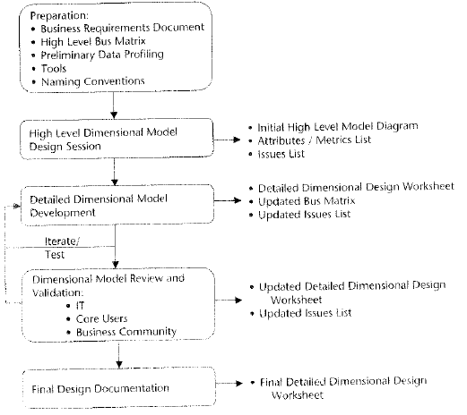
Modeling Process

Slide 51
4 steps of dimensional modeling
Choose a business process
Declare the grain
Identify dimensions
Identify facts

Slide 52
High-level model diagram
Is a data model at the entity level
Shows specific fact and dimension tables applicable to a specific business process
Great communication and training tool
Currency
Date
Order, Due
Product
Promotion
Orders
Order junk
Channel
Customer
Sales person

Slide 53
Derived facts
Additive calculation using other facts in the same table
  Can be calculated using a view
  Example: net sales based on subtraction of commission amount from the gross sales
Non-additive calculation that is expressed at a different level of details than the fact table itself
  Can be calculated by BI tools at the time of query
  Example: Year-to-date sales

Slide 54
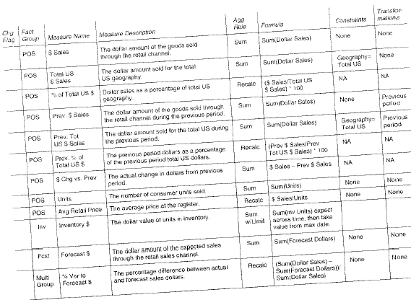
Derived facts

Slide 55
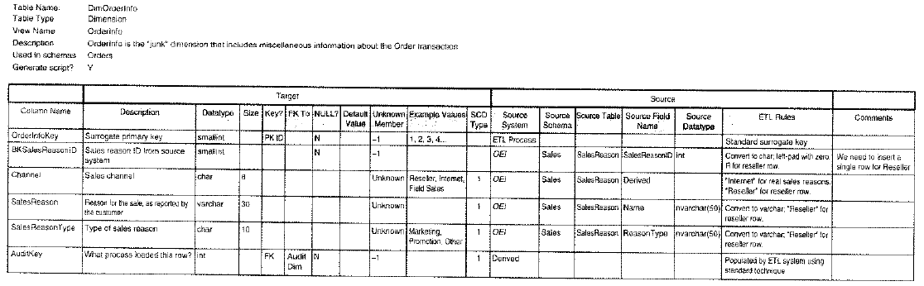
Detailed Dimensional Design Worksheet

Slide 56
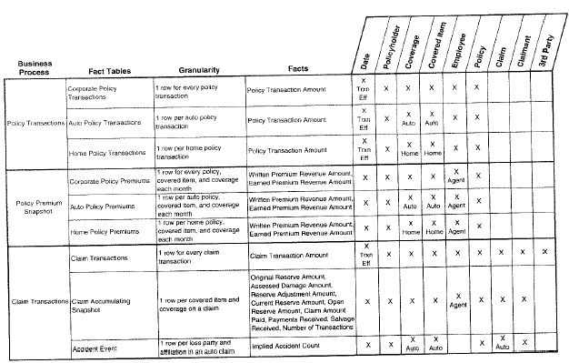
Updating bus matrix

Slide 57
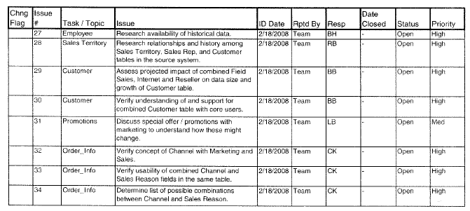
Sample Data Model Issue List

Slide 58
Design document
Brief description of business processes included in the design
High level discussion of the business requirements to be supported pointing back to the detailed requirements document
High level data model diagram
Detailed dimensional design worksheet for each fact and dimension table
Open issues list highlighting the unresolved issues
Discussion of any known limitations of the design to support the project scope and business requirements
Other items of interest, such as design compromises or source data concerns)

Slide 59
Questions ?

